Slide 1
The start of the details
Functional Behavioural Analysis
Lecture Week 4
Deck 1
Mr DJ Kritzinger
August 2026

Slide 2
Today….
FFBDs a quick introduction and graphical rules
Details of the functional flow constructs
When to halt decomposition

Slide 3
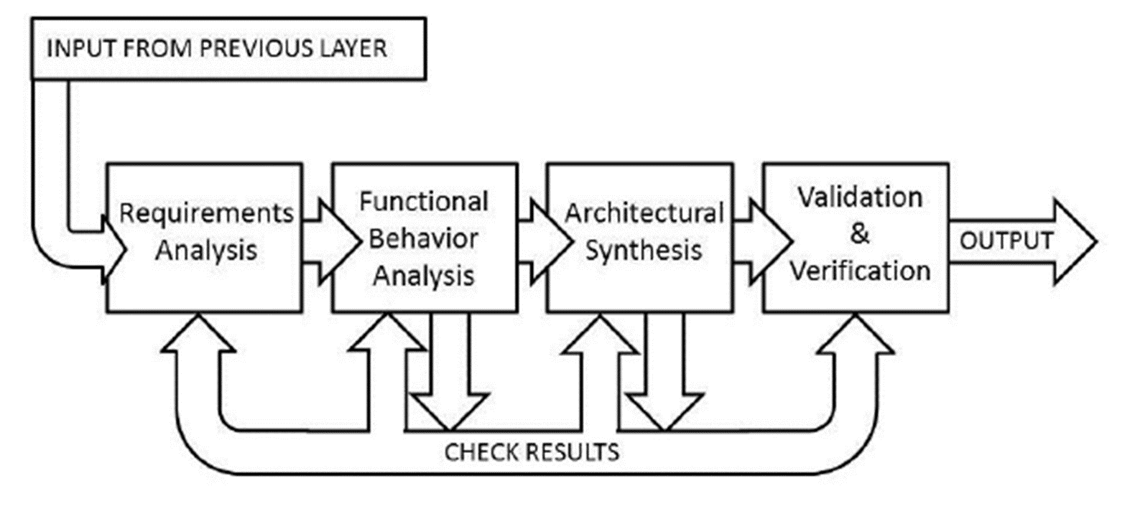
Getting into the functional side
Notes:
Once the SE deems the RA phase to be sufficiently detailed, the analysis phase progresses to the Functional Analysis phase. As indicated in the figure, the SE is welcome to return to RA should the need arise.

Slide 4

Functional Analysis
Analysis tool
Behaviour of the system on a lower / per function level
No direct physical mapping
Clarifies “WHAT” happens in a specific mode (or collection of)
Functional decomposition by means of block diagrams
Functional flow block diagrams (FFBDs)

Slide 5
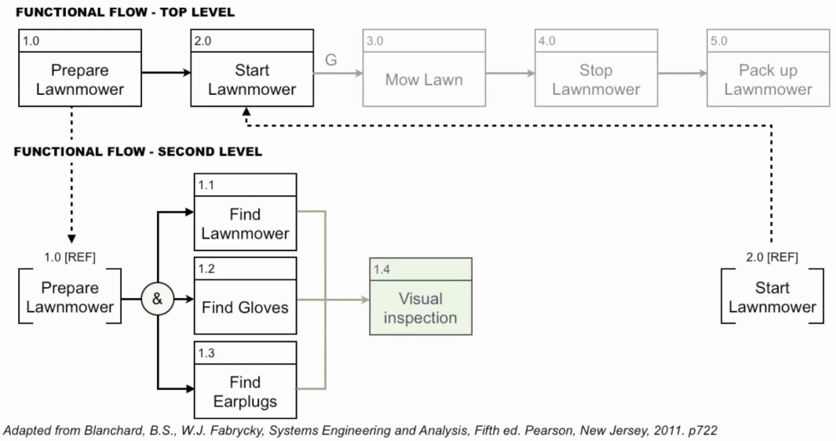
FFBD a simple example
?

Slide 6
Rules for developing functional decomposition
Start with a life-cycle perspective of the system
Include all system functions in a single element
Expedite process and only consider the operation of the system

Slide 7
Decomposing elements

Slide 8
FFBD Rules – A function
Reference number for this element
(Functional / Unit)
Flow continues from here if Function X was successful
F/U 1.0
System performs function X
G
Flow from previous functional element
G
Flow continues from here if Function X failed
Function description must contain a VERB
Notes:
All functions must have a name. Since we are describing what the system is supposed to DO you must make use of VERBS

Slide 9
FFBD Rules – A reference function
Box denoted by dashed lines
REFerence number must maintain traceability
REF x.y.z.2
System performs function X
Typically only input or output are present

Slide 10
FFBD Rules – OR construct
Both must be included
F/U 1.0
System performs function X
OR
OR
MUTUAL EXCLUSION
F/U 2.0
System performs function X
Constructs can carry many functions…
F/U 3.0
System performs function X

Slide 11
FFBD Rules – AND construct
F/U 1.0
System performs function X
&
&
POTENTIAL CONCURRENCY
F/U 2.0
System performs function X

Slide 12
FFBD Rules - Iterator
Number of iterations
F/U 1.0
IT
System performs function X
IT
Function X will be performed <number of iterations> times before continuing

Slide 13
FFBD Rules - Replicator
Number of replications
F/U 1.0
RP
System performs function X
RP
Function X will be performed in a defined number of instanced. Possibly concurrently

Slide 14
FFBD Rules - Loops
F/U 1.0
LP
System performs function X
LP
G
Function X is performed in a loop.
LE
LE could also be as result of completion of another function
Upon encountering the loop exit (LE)
execution transitions to the trailing LP
and continues from there

Slide 15
FFBD Rules – Modelling boundary
MISSILE LAUNCHING CONTEXT
The context’s content is illustratory
REF 1.2.0
F/U 1.2.1
F/U 1.2.2
Launch missile
System performs function X
System performs function X
F/U 1.2.3
Context must have a name and dashed enclosing box
System performs function X
REF 1.2.0
OR
OR
Launch missile
F/U 1.2.4
System performs function X
Reference blocks enter and exit context

Slide 16
Types of Functions
Type A
Solely performed by the system
Decompose Type B,D
Type B
Partly performed by the system
Type C
Not performed by the system
Interfaces to the system
Done by ONE (1) item in the system context
Type D
Not performed by the system
Interfaces to the system
Done by TWO (2) or more elements in context
Type CI
Not performed by the system
Interfaces to the system via enveloping environment
Done by ONE (1) item in the system context
Type E
Not performed by the system
Interfaces to the system
No element in context to perform action
Refine context to change Type E

Slide 17
When to stop?
Once only type A,C, CI functions are left
Type A
Solely performed by the system
Type C
Not performed by the system
Interfaces to the system
Done by ONE (1) item in the system context
Type CI
Not performed by the system
Interfaces to the system via enveloping environment
Done by ONE (1) item in the system context

Slide 18
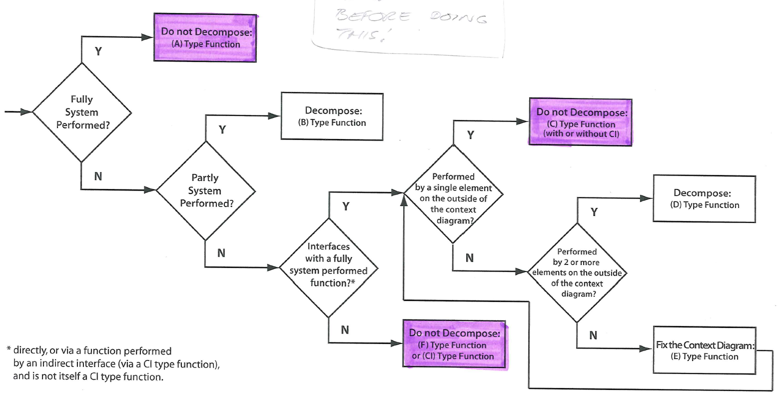
Cheat sheet

Slide 19
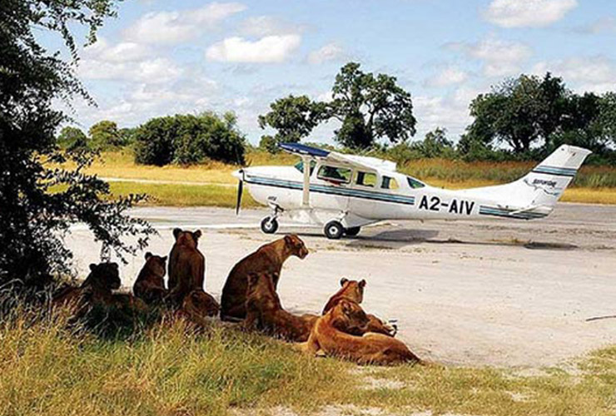
A quick example
You are developing an aircraft system to replace existing infrastructure

Slide 20
A quick example
B
B
B
B
B

Slide 21
A quick example
E
D
A
A
B
C

Slide 22
A quick example
F
C
C

Slide 23
A quick example - FFBDs

Slide 24
Recap
Discussed FFBD constructs
Looked at when to stop decomposition
Considered an academic example

